Slide 1
Physical Education
6th Grade
Stretching the Right Way
Mr. Sims

Slide 2
During this Chapter, the students will learn:
The importance for proper stretching
How to select the proper stretch
How to demonstrate a stretch
Create a journal log during workouts
How to use the internet for research
of different stretches
This picture was found in Micro-soft clip art.

Slide 3
Stretching is:
a form of physical exercise in which a
specific skeletal muscle (or muscle group)
is deliberately stretched
This picture was found in Micro-soft clip art.
Benefits of proper stretching:
a feeling of increased muscle control
greater flexibility and range of motion
help therapeutically to alleviate cramps
will help to reduce injuries

Slide 4
The Proper Stretch
Selecting the proper stretch is essential
prior to competing in a gym class activity
or sporting event.
For example, prior to starting
a daily jog – you will need to
stretch your lower extremities
and back
This picture was found in Micro-soft clip art.

Slide 5
The Proper Stretch - (continued)
Important Facts:
certain stretching techniques and protocols
prevent injuries when performed (within 15
minutes) prior to exercise
stretching does not prevent delayed onset
muscle soreness, neither when performed
before nor after exercise
one stretching exercise may not be enough
to prevent all types of injury, therefore,
multiple stretching exercises should be used
to gain the full effects of stretching

Slide 6
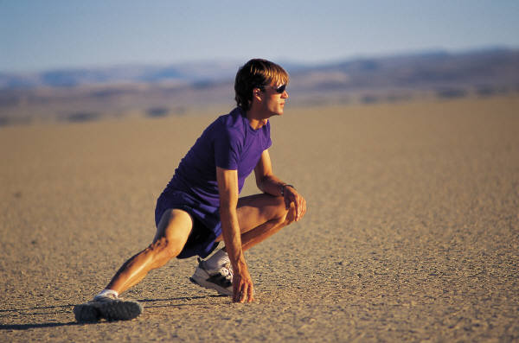
For additional examples go to listed
links below.
http://www.brianmac.co.uk/stretch.htm
http://en.wikipedia.org/wiki/Stretching
http://k2.kirtland.cc.mi.us/~balbachl/stretch.htm
http://www.easystretchingexercises.com/
http://www.mayoclinic.com/health/back-pain/LB00001_D
http://exercise.about.com/cs/flexibility/l/blstretch.htm
This picture was found in Micro-soft clip art.

Slide 7
Students should know:
Increasing flexibility through stretching
is one of the basic tenets of physical fitness.
It is common for athletes to stretch before
and after exercise in order to reduce injury
and increase performance.
Yoga involves the stretching of major muscle
groups, some of which require a high level of
flexibility to perform, for example the lotus
position.
Stretching can strengthen muscles, and in turn
strong muscles are important to stretching
safely and effectively.

Slide 8
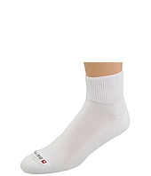
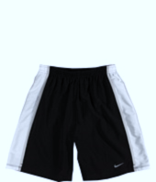
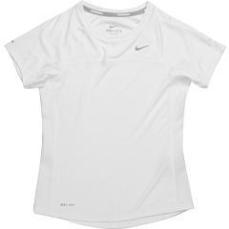
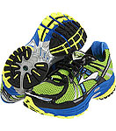
Students must wear proper gym clothing
NO EXCEPTIONS!!!

Slide 9
This is a basic physical education class,
therefore, students are required to dress out
daily and participate regularly.
**********
This is a basic physical education class,
therefore, students are required to dress out
daily and participate regularly.
**********
Five points will be deducted daily for
not dressing out.

Slide 10

Each student will be required to demonstrate how to properly stretch.

Slide 11
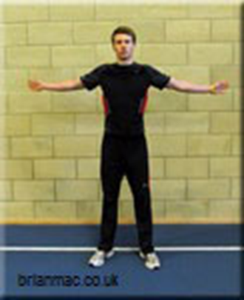
For example:
Chest Stretch
Stand tall, feet slightly wider
than shoulder-width apart, knees
slightly bent
Hold your arms out to the side parallel with the ground and the palms of the hand facing forward
Stretch the arms back as far as possible
You should feel the stretch across your chest

Slide 12
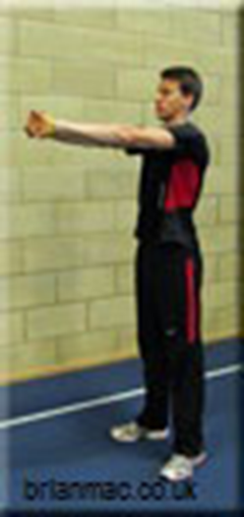
Upper Back Stretch
Stand tall, feet slightly wider than shoulder-width apart, knees slightly bent
Interlock your fingers and push your hands as far away from your chest as possible, allowing your upper back to relax
You should feel the stretch between your shoulder blades

Slide 13
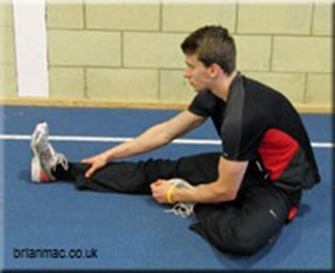
Hamstring Stretch
Sit on the ground with both legs straight out in front of you
Bend the left leg and place the sole of the left foot alongside the knee of the right leg
Allow the left leg to lie relaxed on the ground
Bend forward keeping the back straight
You will feel the stretch in the
hamstring of the right leg
Repeat with the other leg

Slide 14
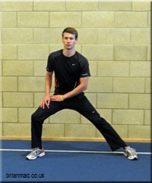
Adductor Stretch
Stand tall with your feet
approximately two shoulder
widths apart
Bend the right leg and lower
the body
Keep you back straight and use the arms to balance
You will feel the stretch in the
left leg adductor
Repeat with the left leg

Slide 15
Students must:
create a journal log create a journal log that displays a daily workout plan
use the internet for research of different stretches and site web pages visited

Slide 16

RUBRIC
Oral presentation
30 points
Demonstrate three
stretches – 25 points
Perfect dress out record
20 points
Create a journal log
10 points
Internet references
10 points
Define stretching – 5 points

Slide 17
Grading System
A = 93 – 100%
B = 83 – 92%
C = 70 – 82%
D = 60 – 69%
F = Below 60%
Extra Credit Assignments are available upon request

Slide 18
Materials & Resources:
The students will not have to purchase anything, for this course.
All class reading material will be provided by the school.
Each student will be given a class syllabus. Inside it will be instructions that states the requirements for this course.
All resources will be governed by the Sunshine States Standards.
The students must have access to a computer, after school hours and be able to log-onto the world-wide-web.

Slide 19

SUPPLIES
Pencils
Composition Note Book
Proper gym clothes
Proper gym shoes

Slide 20
References
(n.a.).(2012) Retrieved April 3, 2012 from
http://www.brianmac.co.uk/stretch.htm
(n.a.).(2012). Retrieved April 3, 2012 from
http://en.wikipedia.org/wiki/Stretching

